Slide 1
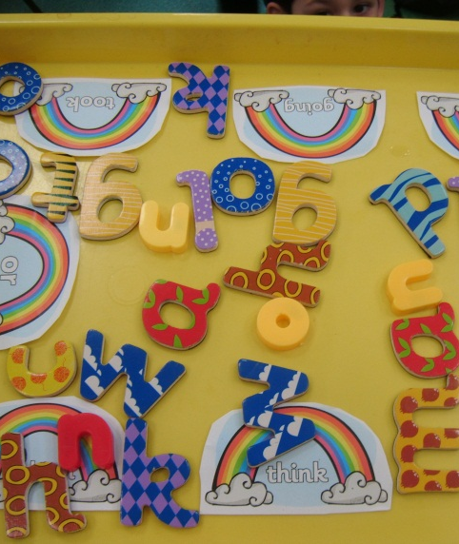
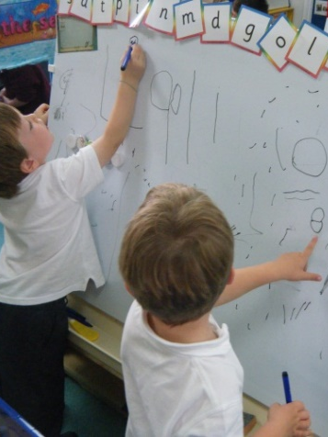
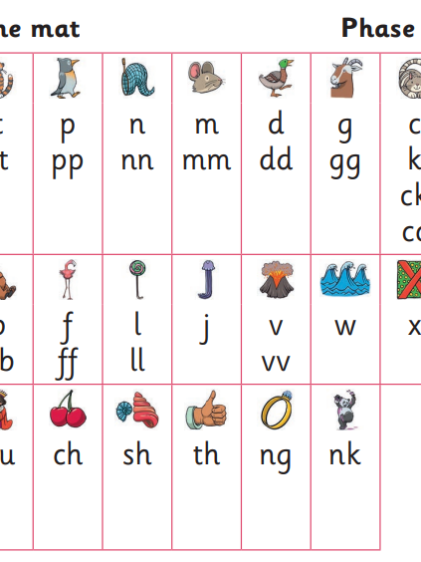
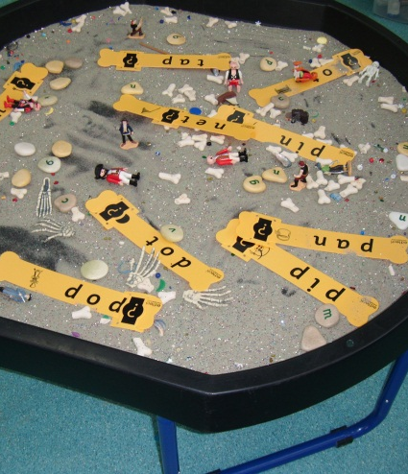
Phonics Year1 November 2023

Slide 2
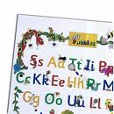
Letters and Sounds
A statutory requirement
Daily-20 minutes high quality phonics provision.
4 x teach and 1 x review session
5 week units
Week 6 assessment week
4 phase approach:
Revisit and review
Teach
Practise
Apply

Slide 3
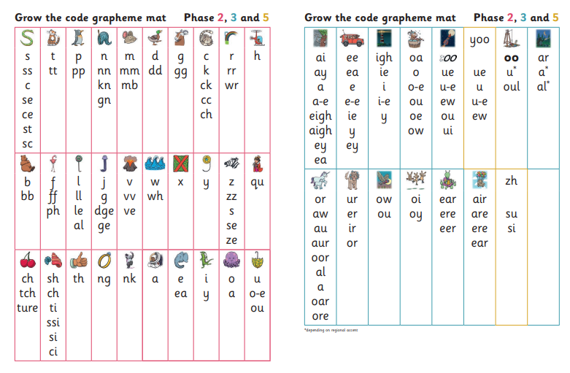
A Phoneme
This is the smallest unit of sound in a word.

Slide 4
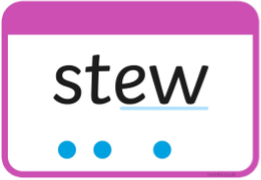
A phoneme

Slide 5
A grapheme
These are the written letters that represent the phoneme.
More than one grapheme may be used to make a phoneme.

Slide 6
Grapheme Key Vocabulary:
Digraph | 2 letters making one phoneme ( ai, ee, oo)
Trigraph | 3 letters making one phoneme ( igh , ear, air)
Split Digraph | Where the two letters are not adjacent ( a-e, e-e )

Slide 7
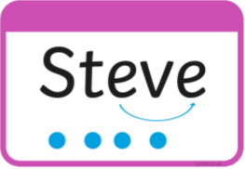
Split digraph

Slide 8
Phonics skills:
Blending phonemes into words for reading.
c-a-t → cat
Segmenting words into phonemes for spelling.
cat → c-a-t

Slide 9
Enunciation
Teaching phonics requires a technical skill in
enunciation.
Phonemes (sounds) should be articulated
clearly and precisely.
Little Wandle Parent Support
www.littlewandlelettersandsounds.org.uk/resources/for-parents/

Slide 10
Other Terminology
High Frequency Word (HFW) – words that occur regularly in texts that children should be able to read. E.g. and, as, it
Tricky words – Words that cannot be sounded out and the children must just ‘know’ them.
Eg the, people, was, could, Mr, Mrs

Slide 11
Phases of Letters & Sounds (L&S)
Phase 1
Nursery and practising within Reception) – playing with and hearing sounds.
Phase 2
Sounds of the alphabet letters, introduce double letter digraphs.
Phase 3
Introduce digraphs and trigraphs.
Phase 4
Practising blending.
Phase 5
Alternative spelling patterns.
Phase 6
Prefixes and suffixes

Slide 12
Phonics Screening Check
All children in Year 1 are required by the government to take this test.
Those children who do not reach the required standard in Year 1 must re-take the test in Year 2.
All testing will take place in June
Testing will take place on a 1:1 basis with an adult who is familiar to the children.
Testing takes a maximum of 10 minutes.

Slide 13
What is involved in the test?
The screening test is testing children’s verbal segmenting and blending skills. There is NO writing involved.
The test is made up of real and pseudo (fake) words. At school we are referring to these as ‘Alien’ words as all pseudo words are identified by alien characters on the cards.

Slide 14
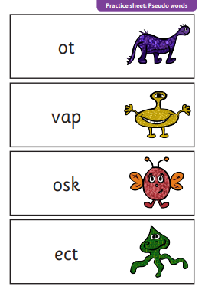
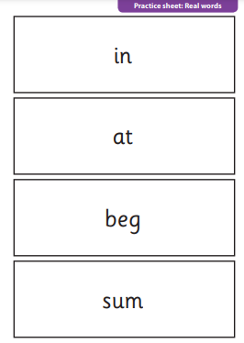

Slide 15
Helping at Home
Little Wandle website
https://www.littlewandlelettersandsounds.org.uk/resources/for-parents/
Videos for enunciation, phase mats to show what the children are learning and when
ICT Games:
http://www.ictgames.com/
http://www.phonicsplay.co.uk/
www.theschoolrun.com
Resources:
Magnetic letters
Phoneme frames
Whiteboards and pens
Pencils and paper
Chalk on chalk boards/the pavement
Phoneme pots
Phoneme/word spot in their reading books
Post- its

Slide 16
Little Wandle at home cards £6.99 each Amazon

